Slide 1
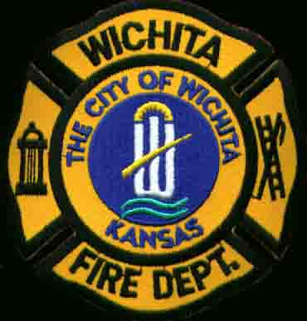
1968 Quadruple LODD Wichita (KS) FD
November 21, 1968
Roof Collapse
Multiple Sources via newspapers.com

Slide 2
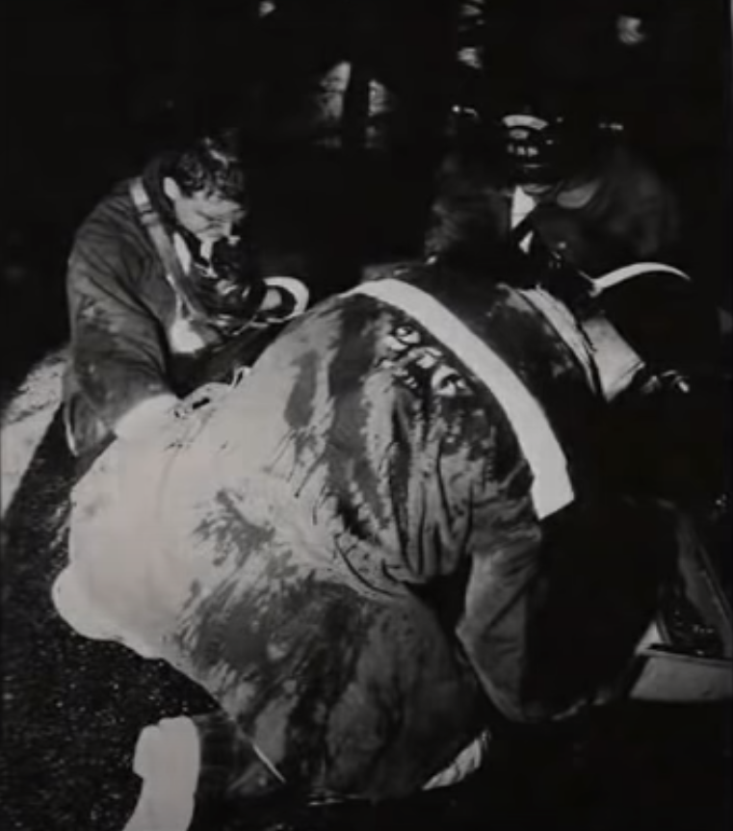
November 21, 1968
21:12 – Fire reported Yingling Chevrolet Dealership in Wichita, KS.
21:14 – First units arrive.
21:20 (approximate) – Major collapse of roof occurs.
Four firefighters killed.
Two firefighters injured.
Fire started in an overhead heater and had burned for approximately 45 minutes before FD was called.
Workers attempted to fight the fire and move cars out of the dealership before calling the WFD.
Single largest Wichita area LODD.
Credit: Wichita Metro Area Fools of Oz

Slide 3
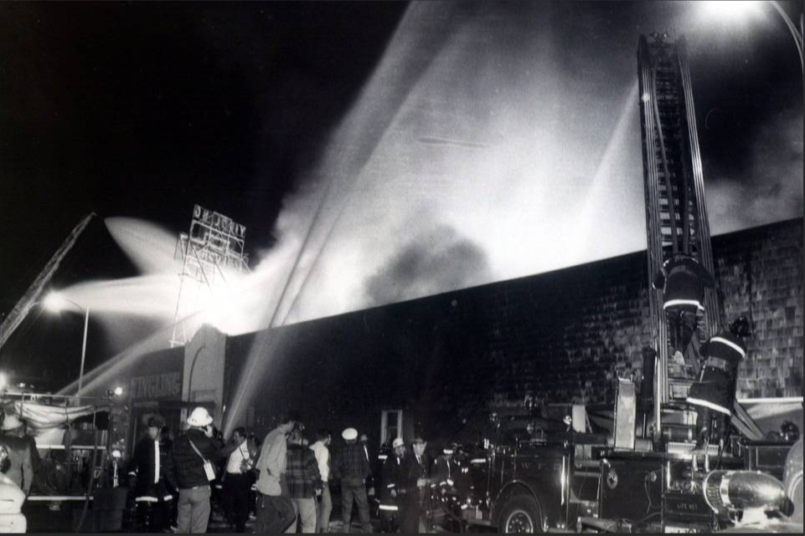
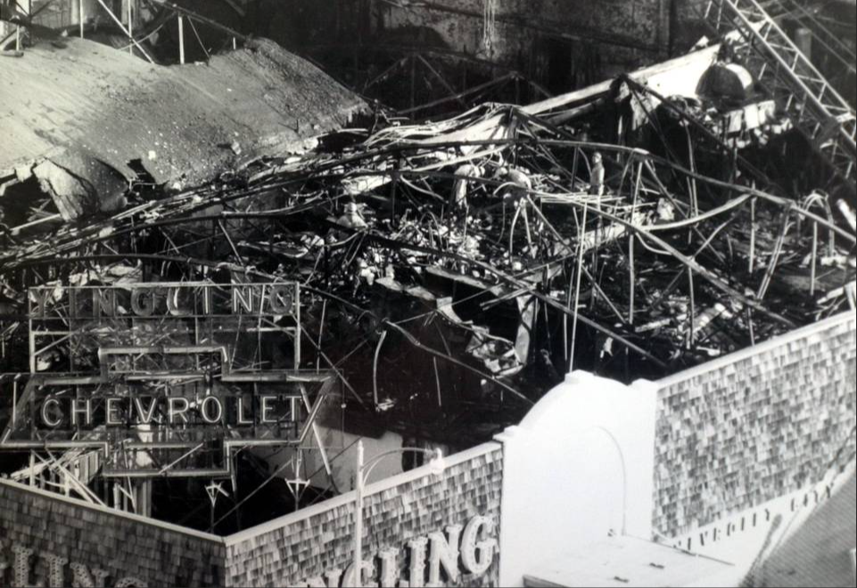
Credit: Wichita Eagle

Slide 4
Credit: Wichita Metro Area Fools of Oz

Slide 5
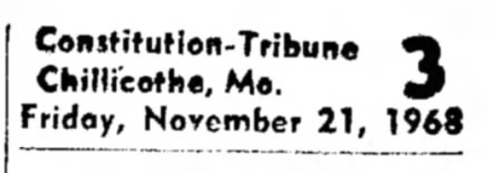
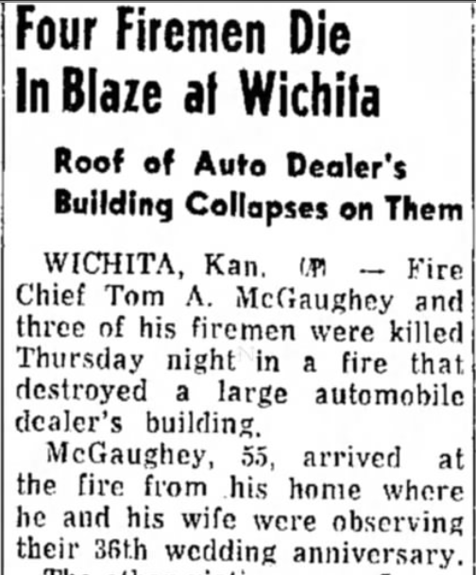
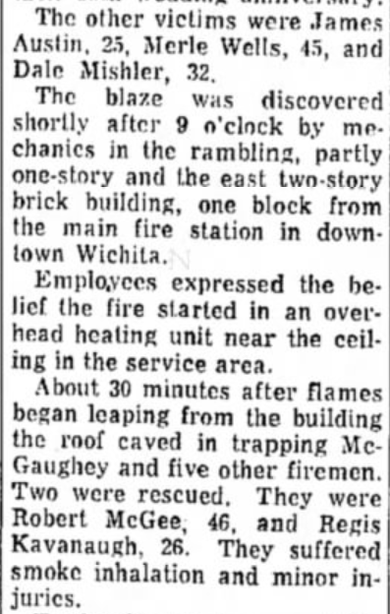
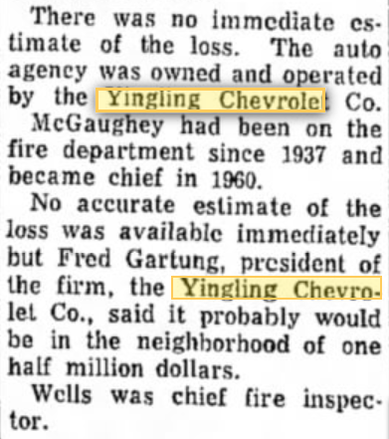

Slide 6
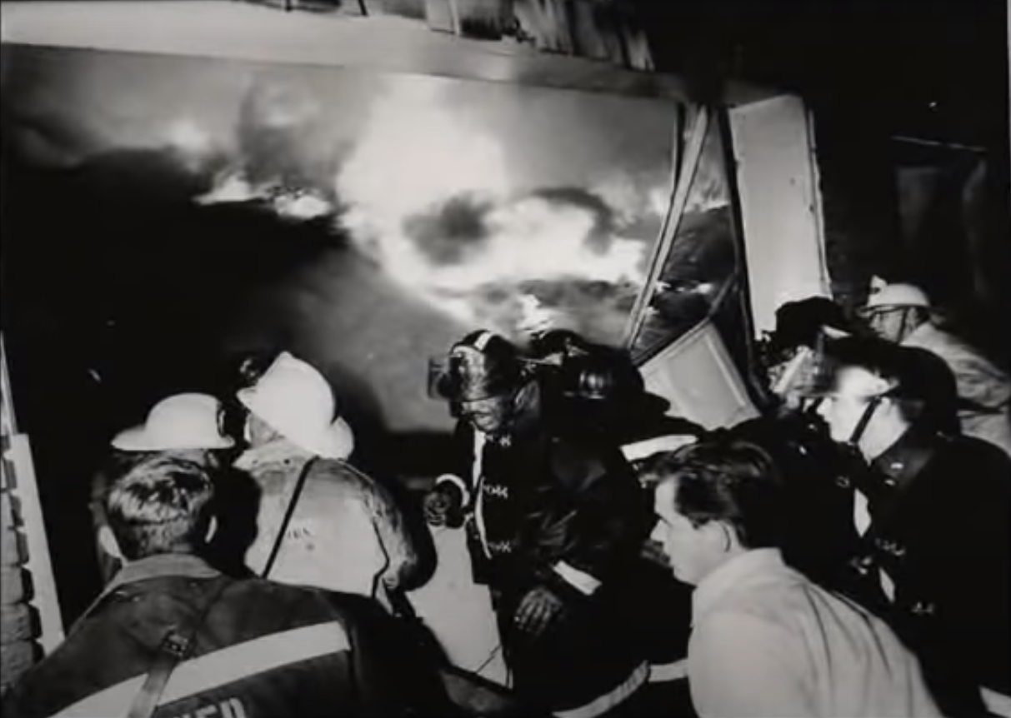

Slide 7
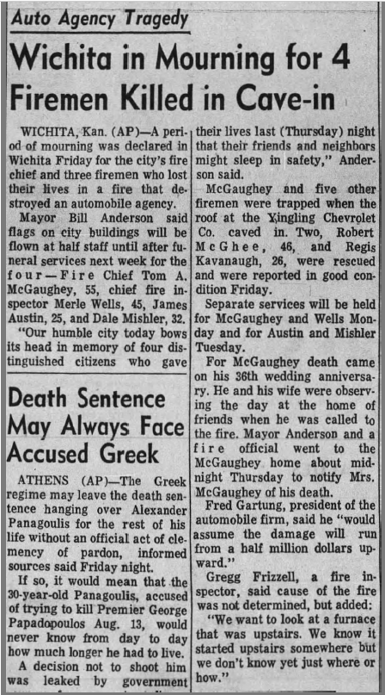

Slide 8
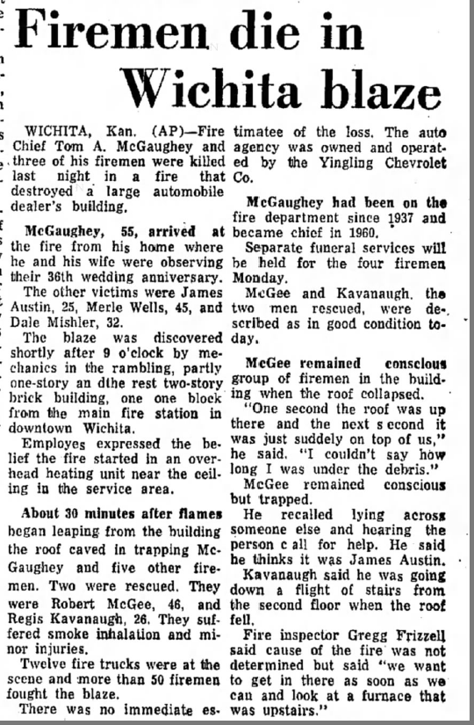
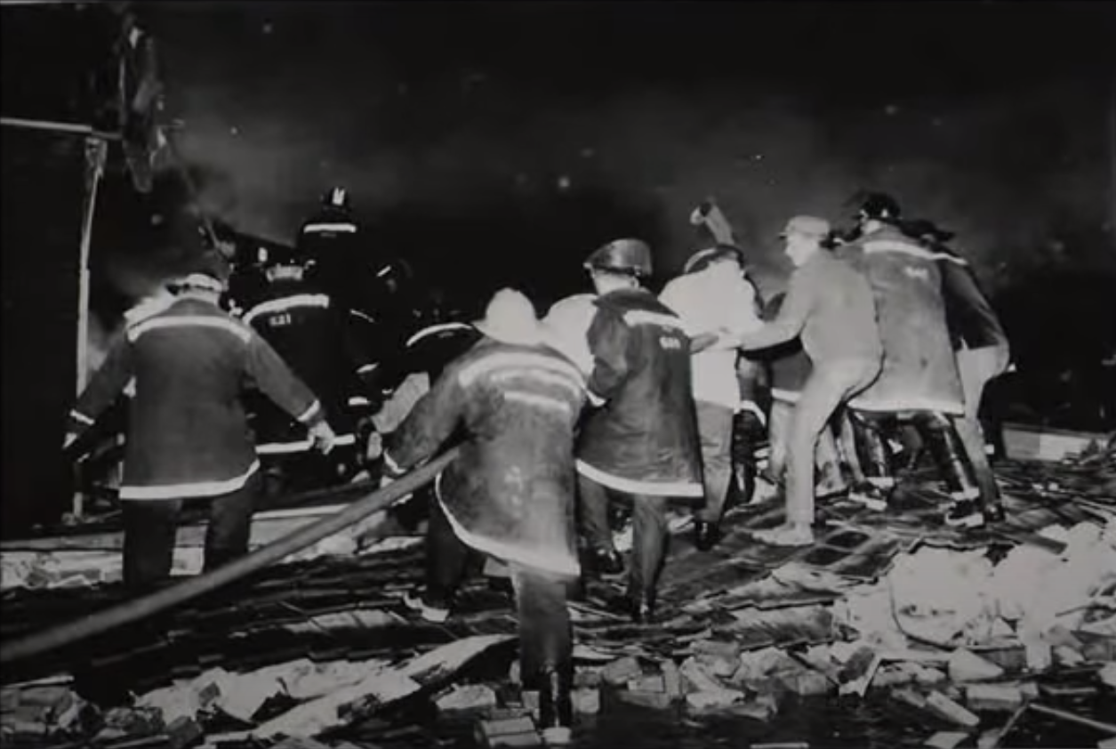

Slide 9
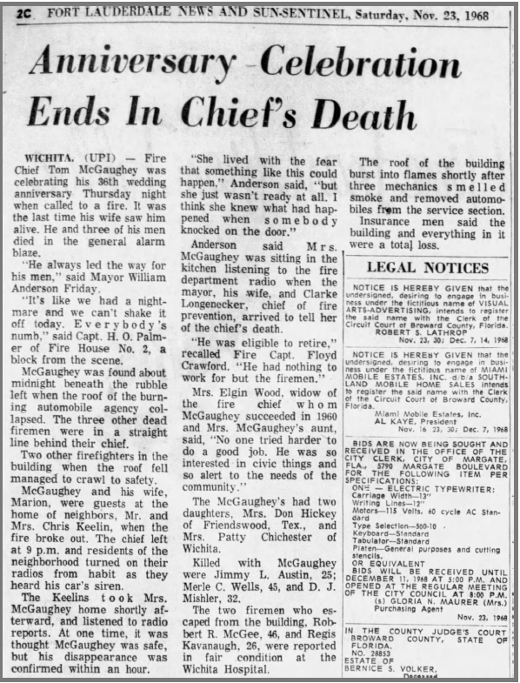

Slide 10
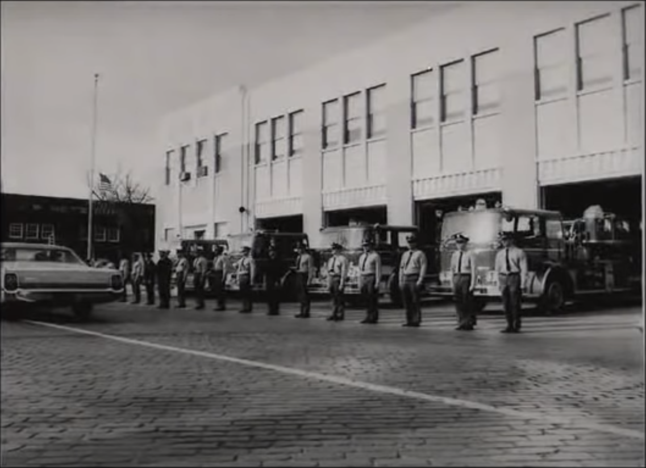
Credit: Wichita Metro Area Fools of Oz

Slide 11
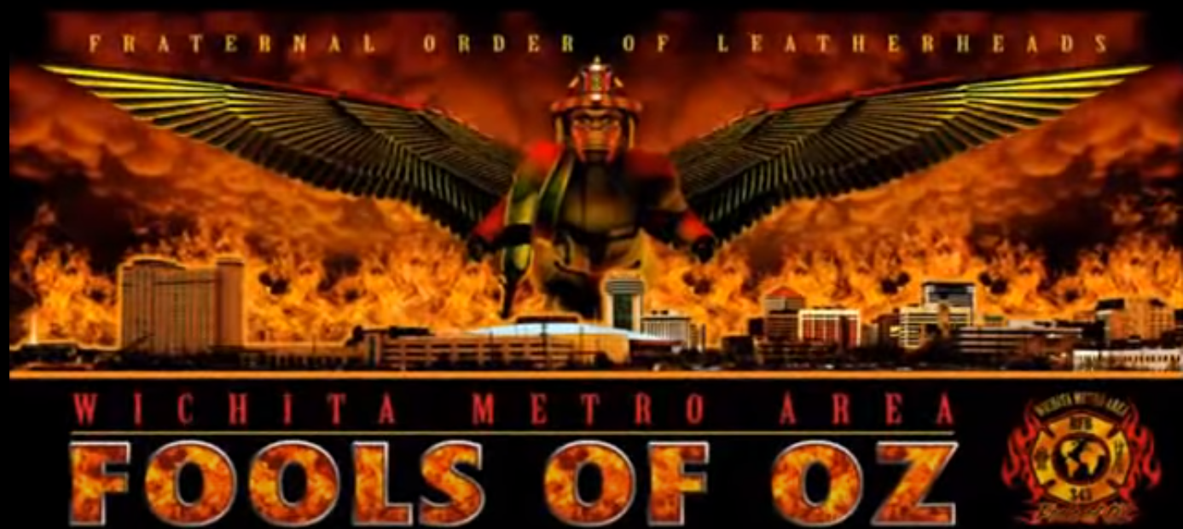
2009
Wichita Metro Area Fools of Oz Tribute
(9:48 Run Time)
Yingling Chevrolet Fire Tribute- Edited - YouTube

Slide 12
We Remember

