Slide 1
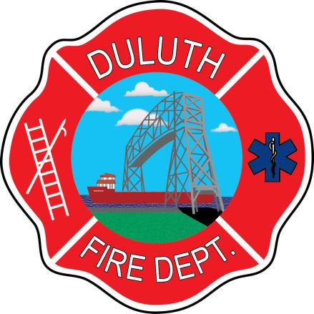
1898 Double LODD Duluth (MN) FD
September 7, 1898
Ladder Truck vs. Streetcar
Text courtesy Ms. Ellen Kreidler, Executive Assistant
Duluth Fire Department
Taken from “Fire and Ice: The History of the Duluth Fire Department”
Images for illustration only

Slide 2
September 7, 1898
Truck No. 3 was dispatched to a chimney fire in a lodging house at the corner of Lake Avenue and Morse Street.
The response route down Lake Avenue was very steep as it approaches Superior Street.

Slide 3
A streetcar was passing slowly eastward through Superior Street.
The motorman was looking the other way and did not see or hear the approaching ladder truck.

Slide 4
Tragic Impact
The ladder driver attempted to steer the ladder truck around the streetcar, but the streetcar struck the rear of the truck, causing the truck to swing around and crash into the curb and a telegraph pole.
Fireman Finlayson and Pipeman Twaddle, standing on the footboard, were pinned under the truck.
Image courtesy Duluth FD “Fire and Ice” Dedication Page

Slide 5
The force of the collision was so great, one of the rear wheels was shattered, with as spoke being driven 3” into the telegraph pole.

Slide 6
In Memoriam
Fireman Archibald Finlayson
Five-year veteran of the DFD.
Left a widow and three children.
Pipeman Arthur Twaddle
14-month veteran of the DFD.
Lingered until 9/13 before dying.
Brother John was a DFD Lt.
Lt. John Twaddle was injured a year later in a wall collapse that killed DFD Firefighter William McVittie.

